Slide 1
Final Report Out
GE Grid
Cash Process work out
I2C, S2P & Cash
25th February 2021

Slide 2
INVOICE TO CASH

Slide 3
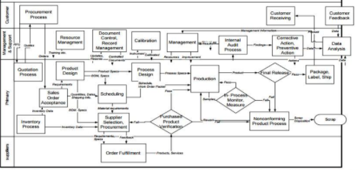

Back
Home
Summary of I2C lean workout
16
35
2
21
15%
Team members participated in the workout
Kaizens (improvement opportunities) identified
Quick Hits / Short Term solutions prioritized
Strategic/Long Term solutions identified
Improvement in automation from 40% to 55%

Slide 4
Current state: Autobank process – I2C
GE Renewables/Grid
35 kaizens identified
Bank Statement EBS Upload
Remittance extraction
Bank Statement and Remittance Processing
Posting, allocation, clearing
Webcash (TRAX) Data extraction
(to SAP via Middleware)
Remittence extraction
(SmartEye)
Automated processing of bank statement and remittances in SAP
Posting step 1
(Booking of Bank Statement in SAP: Main GL to Autobank Clearing Account)
Posting step 2
(Post payments to AR Subledger: clearing against invoice) automated
Posting step 2
(Post payments to AR Subledger: clearing against invoice)
Manual
NVA/WT
Processing Time*
5 mins
5 mins
5 mins
5 mins
1 mins
Autobank process is working 24/7 with inmediate processing when input files are available. Rules are available in the next slide.
One case can have one or multiple issues
* Times are estimated

Slide 5
Effort – Impact matrix
Quick Hits / Short Term
Strategic/Long Term
“Quick hits / Just do it”
“Strategic”
JDI
Projects
High
Impact
“May be”
“Pass”
Low
Low
High
Effort

Slide 6
Effort – Impact matrix
Quick Hits / Short Term
Strategic/Long Term
K1
K3
K5
K6
K8
K9
K16
K2
K4
High
K10
K12
K13
K14
K15
K18
K28
K19
K24
K29
K33
K34
K 35
K22
Impact
K17
K20
K21
K11
K7
K25
Low
K26
K27
K31
K32
K30
K23
Low
High
Effort

Slide 7
Categories
SYSTEM
DATA
15
7
PROCESS
CUSTOMER INPUT
9
4

Slide 8
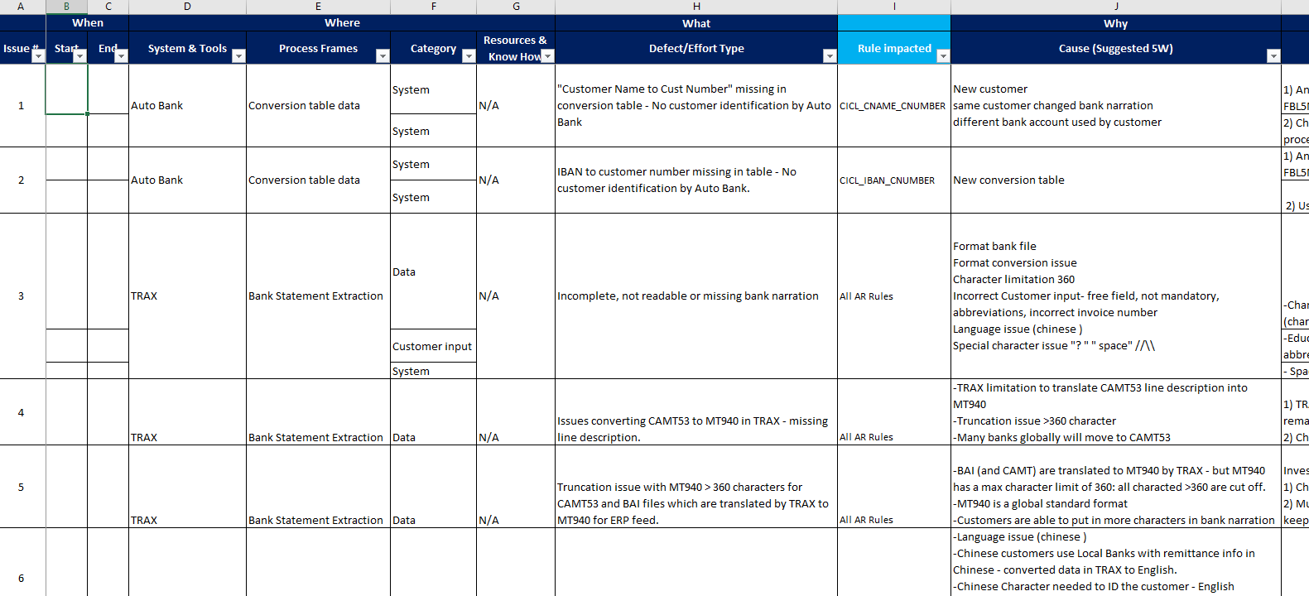
Kaizen details

Slide 9
Auto Bank Improvements
*
Based on January analysis
Impact depending on System, Process, Data, Customer input
% improvement indicative of end-to-end solutions for the drivers

Slide 10
Implementation roadmap / Action plan 1of2
# | System & Tools | Solution | Owner | Completion date* | KPI – Bowler metric | Issues / Challenges / Help needed
K1 | Autobank | Check auto update option from PP screen & confirm update process with AML team | TBD | Not started | TBD | TBD
K2 | Autobank | Use Sending bank details Table (MICR, IBAN) auto update | TBD | Not started | TBD | TBD
K3 | Autobank | Analyze and update Table (Serrala use business partner, BSEG, FBL5N0) | TBD | Not started | TBD | TBD
K4 | Autobank | Use Sending bank details Table (MICR, IBAN) auto update | TBD | Not started | TBD | TBD
K7 | TRAX | Space removing in Bank file narration in Auto bank | TBD | Not started | TBD | TBD
K12 | Remit Library, OCR | Auto forward rule from other mailbox to Renewables global one -Educate Biz Sales/ PM / Collections / Cash to forward (Banner in CRM system) | TBD | Not started | TBD | TBD
K13 | Remit Library, OCR | 'Educate Customer to send remittance to the correct email box - remit library. Add email address in Collector email signature | TBD | Not started | TBD | TBD

Slide 11
Implementation roadmap / Action plan 2of2
# | System & Tools | Solution | Owner | Completion date* | KPI – Bowler metric | Issues / Challenges / Help needed
K14 | Remit Library, OCR | 'Invoice templates to be validated and updated with correct email address for Renewables. | TBD | Not started | TBD | TBD
K19 | TRAX, Auto Bank | Investigate special characters in Auto Bank | TBD | Not started | TBD | TBD
K22 | Auto Bank, SAP | Fix for 1 WBS scenarios in Auto Bank. Payment split in >1 WBS require manual workaround via GL | TBD | Not started | TBD | TBD
K24 | Auto Bank | New rules on non_AR incoming | TBD | Not started | TBD | TBD
K28 | Remit Library, OCR | Check with Serrala | TBD | Not started | TBD | TBD
K29 | Remit Library, OCR | Check with Serrala | TBD | Not started | TBD | TBD
K34 | Auto Bank | Implement WBS fix and stop reversal and use AR rules to apply cash in Auto Bank | TBD | Not started | TBD | TBD

Slide 12
RTR

Slide 13

Summary of RTR lean workout
20
34
13
21
20%
Team members participated in the workout
Kaizens (improvement opportunities) identified
Quick Hits / Short Term solutions prioritized
Strategic/Long Term solutions identified
AutoBank increase from 50% to 70%

Slide 14

Auto Booking
Auto Booking Failed
Incomplete Bookings
Single PC for Cashpool Postings
Open item categorization
Limited Auto Target GL booking
Duplicate/Double Bookings
Checking/clearing xx5 Clearing GL- Cash Team
Open item Follow up
Manual Cash pool Interest booking
NVA/WT
0.74 Hr.
8.82 Hrs
1 Hr.
PT
0.74 Hrs
5.15 Hrs
16.54 Hrs
11.03 Hrs
8.82 Hrs
17.64 Hrs
7.35 Hrs
5.88 Hrs
4.41 Hrs
10.29 Hrs
24.99 Hrs
Bank Statement Upload & checking
Item Assignment, Follow Up & Clearing
Closing Activities
Reconciliations
GL system close
(Blackout Period)-Manual booking
Webcash Data extraction & booking (Manual/AutoBank)
Webcash check vis-à-vis Bank GL plus other GL check
Identification & Assignment of open Items
Matching & Clearing
Manual /Reclass JEs in case of no/wrong postings
Follow-ups/report out on open items
Closing -Cashpool Match
Closing – Int. booking & Accrual
Closing
-Reval run & checking
Hedging/
Ad-hoc Requests
Reconciliation Preparation & Submission on ARM
PT
14.70 Hrs
11.03 Hrs
22.05 Hrs
11.03 Hrs
11.76 Hrs
23.52 Hrs
7.35 Hrs
5.88 Hrs
4.41 Hrs
10.29 Hrs
24.99 Hrs
NVA/WT
5 Hrs
13.97 Hrs
5.88 Hrs
5.51 Hrs
2.94 Hrs
5.88 Hrs
8.82 Hrs
1 Hr
Manual Booking
Matching and Clearing requires Manual intervention
High Impact Kaizen
Late availability of final cash pool calculation
K1-
5 days blackout period
Low Impact Kaizen

Slide 15
Effort – Impact matrix
Quick Hits / Short Term
Strategic/Long Term
K 1
K 17
K 16
K 4
K1
K7
K 26
High
K 19
K 25
K 11
K 15
K 27
K 32
Impact
K6
K8
K3
K30
K5
K9
K31
K22
K2
K12
K14
Low
K33
K20
K21
K10
K24
K13
K18
K23
K34
K29
Low
High
Effort

Slide 16
Categories
PROCESS
SYSTEM
4
7
PROCESS/SYSTEM
SYSTEM/DATA
15
8

Slide 17
Implementation roadmap / Action plan
# | System & Tools | Solution/Next Steps | Owner | Completion date | KPI – Bowler metric | Issues / Challenges / Help needed
I | Autobank Rule Creation / Modification | Creating new rule in AutoBank Cashpool, Bank Charges, Direct Debit, Fx, Rejection, Payroll Improve matching/clearing % for Payment Run rule and by using F.13 T-Code Providing additional information to Key User for further research on AutoBank Auto booking to target GL for Freight Transactions Increase AutoBank ratio by improving input data/bank narration Payroll - Increasing AutoBank ratio by improving input data | Key User Cash Treasury Bank Infra | Not started | To Be agreed on draft bowler | Key users to evaluate the scenario for its success
2 | Improving Cash Process | Automation of ARM reconciliation preparation & upload Automation of OI Categorization and reporting | Gabor Bathi Cash | In-Progress | To be agreed on draft bowler | Opportunity for BOT implementation
3 | Improving Upstream process step | Consistent AP FX/Rejection transaction booking/reduce the number of payment rejections Improve process for manual payments (MyPayment) transactions/Enabling mandatory fields Payroll team to create SOP for E2E payroll process Improve bank statement quality & OI identification process/input change (SAP/Trax) Improve upstream process for bank charges v/s tax, loan v/s interest Change AutoBank Direct Debit process/create new rules for target GL booking/Process Mapping with S2P to reduce the Direct Debit transactions/Change in Trax/WebCash to include Mandate ID | AP/S2P Payroll Cash Treasury ICO Key User | Not Started | To be agree on draft bowler | Implementation of upstream process fixes to reach the desires target state
AutoBank % Increase from 50% to 70% (Increase in TC Penetration by 10% & Process Improvements by 10%)

Slide 18
Operating Rhythm and next steps ….
Governance rigor
Next Steps…
Leadership call GP/REN early March to schedule
Agreement on productivity targets
Buy-in for organizational accountability
Approval to move ahead with proposed model / go/no-go diecission on Autobank
Agreement on governance for 2021 (Ownership & accountability for the 2021 Pdty)
Bowler agreement
Define and setup detailed Governance rythm
Execution on Kaizan
Executive governance review
Strategic executive (quarterly)
Monthly management committee
Monthly productivity pacing
Monthly OC Touchpoint
GE-G Weekly transformation pulse
Weekly digital program update
Weekly operating

Slide 19
Annexure

Slide 20
Charter | HMS GE Grid Workout
Business Case
Goal Statement
GE Grid one of the most strategic business accounts, have made various investments over last few years to hold even stronger footprint in the industry, providing best in class services to clients.
Auto Bank is one such initiative where the current performance clearly directs towards transformation, both in terms of Cash Process and enhancing automation to generate accuracy and productivity. To meet the Organization vision around Ops Excellence, it is inevitable for all inter process / upstream teams including I2C and OC Cash to design an optimization framework focusing on standardize approach, overcomes derived challenges, including
Revisit and Adherence to Performance Metric
Automation
Synergies - wing to wing process
End to End Deep dive Analysis on processing time and capacity by looking at end to end of I2C, S2P and Cash Process. Preparation consists of process mapping, data collections & analytics
a. Make a complete inventory of the problems in Auto bank
b. Define detailed actions to get 100% automation and accelerate productivity benefits. c. Agreement about ownership of the automation going forward / Define R&R
Scope
Functions: OC Cash / Intercompany , I2C, S2P & C&B
Region: Global
Focus on ALTAIS bank accounts serviced by GENPACT
Any transaction in the bank account posted manually to a S/L or to a B/s account will be considered as a defect.
Goal: 100% of the transactions in the bank statement should be applied to a S/L item or booked in the correct B/s account automatically – 100% of the cash accounts should be automatically reconciled on a monthly basis.
Problem Statement
Model Line approach between OC Cash and other Service Lines to ensure better coordinated outcomes for business
Accelerated Transformation Strategy, better utilization of Automation tools to drive impact faster - S/L and account rec automation % is below market averages impacting achieving the productivity targets
Key Stakeholders and Team
Identify Business Outcome & Impact
Genpact Sponsorship: Sriram Nagarajan (OC) / Darryl Stratton (C2C)
Genpact Leadership: Holger Schramm / Andrew Zimpfer
GE REN Workout Lead: Giuseppe Farago
Identify End to End Cash process improvement opportunity
Valuestream with list of Defects/Waste prioritized by Impact on Automation
Action plan / solutions to eliminate defects also in the upstream processes
Improve usage % in Autobank booking and matching
Measurement progress / Bowler
Agreement on benefits actual / future
Core Team to Workout:
See Page 5

Slide 21
Process Map As Is – Cash Accounting & Reconciliation (PL7)
Daily / Weekly Tasks
Month / Quarter Closing
Reconciliation Cycle
Bank Statement Upload
CP Interest, Edit Check, Reval Check & other MJE booking
Gather supporting back-up for Bank & GL balances
Upstream Feed for ‘Offset’
Matching/Clearing
Perform matching for MJE / OI resolved by upstream
Prepare & attach OI list, if OI balance not moved due to not meeting ES
Pull GL Activity, Identify unmatched transactions
Prepare final list of OI not resolved
Prepare reconciliation template
Checklist
Prior Categorization
Categorize & Investigate unmatched transactions
Propose MJE for moving unresolved balance from CC to respective upstream BS category
Upload reconciliation in ARM
Open Items Follow-up /Reporting
Reconciliation reviewed & approved
Post MJE & perform matching
OpMac calls with upstream
GL v/s Bank account balance validation – TB Tie Out
AutoBank / Manual
Upstream Process Issues

Slide 22
Cash R2R
Treasury
Vendor Master COE / AR
Inter-Co
B2P
AR
C&B
Cash R2R
FP&A
PL 1
PL 2
PL 3
PL 4
PL 5
PL 5
PL 6
PL 7
Bank Account Set-ups
Vendor Master COE / AR Set-up
Initiate/ settle/ reconcile ICO payments
Invoice closure & reconcile AP in SL
Collect/ Apply Cash
Collect/ Apply Cash
Account & Reconcile Cash
Reporting & Forecasting
Priority Areas
# of unmapped accounts
Bank statement quality issues
Payment Failure
Vendor Master Data Missing/Accuracy
Customer Master Data Missing/ Accuracy (Customer set-up issue with UK entity)
Aged Open Items
Payment cut-off adherence
Timeliness of invoice closures in SL
Payalone flag (Payment at invoice level – one to one matching)
Aged Open Items
Payment cut-off adherence (LCD-3 or LCD-4)
Direct Debits process
Manual Payments process
AP FX Transactions
Supplier Returns/Refunds
Payment at vendor level and GL booking at invoice level
Aging of AR related open items
Delay in Cash Application
Partial application (over/under)
Customer Refunds
% Auto Application
% Auto booking
% Auto-matching and Clearing
% Automated reconciliation -ATM to ARM / BOT solution
% Zero unreconciled Accounts
No open items >15 days.
Auto Categorization and OI dashboard
Aged Open Items
Booking cut-off adherence

Slide 23
Process Map As Is – Auto Bank
DAILY AUTOBANK PROCESS/INTERFACE BY EBS TEAM
Treasury sends Bank data input file to EBS team
Avg. 61%
60% TCs (only for Payment Run Rule)
Is Target GL account booking set-up?
Yes
AutoBank books transactions to Target GL account
Manual matching or AutoBank perform auto clearing between Main Bank line and interface line from Sub Ledger (One To One Clearing)
END
EBS team upload input file in SAP
No
Cash reconciler follow up with respective upstream team for booking. E.g. AP, Payroll, IBS
AutoBank books transactions to Main Bank and then to Misc. GL account (XX5)
Is this outgoing payment?
AutoBank park the transaction in xx2 (Outgoing) GL account
Yes
No
AR team books remaining transactions in AR/Customer SL account manually
Is this related to AR?
Yes
AutoBank books transaction in AR/Customer SL account
END
43%
Basis Sample Data
No
AR team books it in xx1 GL Account
Cash reconciler follow up with respective upstream team for booking. E.g. AP return/refund

Slide 24
Bowler (Illustrative)
Agreement on Bowler during workout on how to measure Genpact efficiency and GE defects, which leads to inefficiencies
Objective | Target to Improve
 |  | Target | Month | Jan | Feb | Mar | Apr | May | Jun | Jul | Aug | Sep | Oct | Nov | Dec | 2022 | 2023
Zero Unreconciled accounts | 100% reconciled accounts | 0 Unrec | PY |  |  | 53 |  |  | 25 |  |  | 21
 |  |  | Plan
 |  |  | Actual
Reduction in OI - No OI >15 Days | Moving from >365 to under 15 days | Open items <15 days | PY |  |  | >365 |  |  | >365 |  |  | >365
 |  |  | Plan
 |  |  | Actual
Auto-booking 95% | Moving from 52% to 95% | 95% | PY | No Tracking |  |  |  |  |  |  |  | 52%
 |  |  | Plan
 |  |  | Actual
Auto-matching 95% | Moving from ~20% to 95% | 95% | PY | No Tracking |  |  |  |  |  |  |  | 20%
 |  |  | Plan
 |  |  | Actual
Auto OI Categorization 90% | Moving from 7% to 90% OI categorization * | 90% | PY |  |  |  |  |  |  |  |  | 7%
 |  |  | Plan
 |  |  | Actual
Automated reconciliation -ATM to ARM / BOT solution | Moving from 40% to 100% auto rec of cash process | 100% Auto rec of Cash process | PY |  |  | 36% |  |  | 36% |  |  | 40%
 |  |  | Plan
 |  |  | Actual

